Slide 1
WATER LEVEL INDICATOR

Slide 2
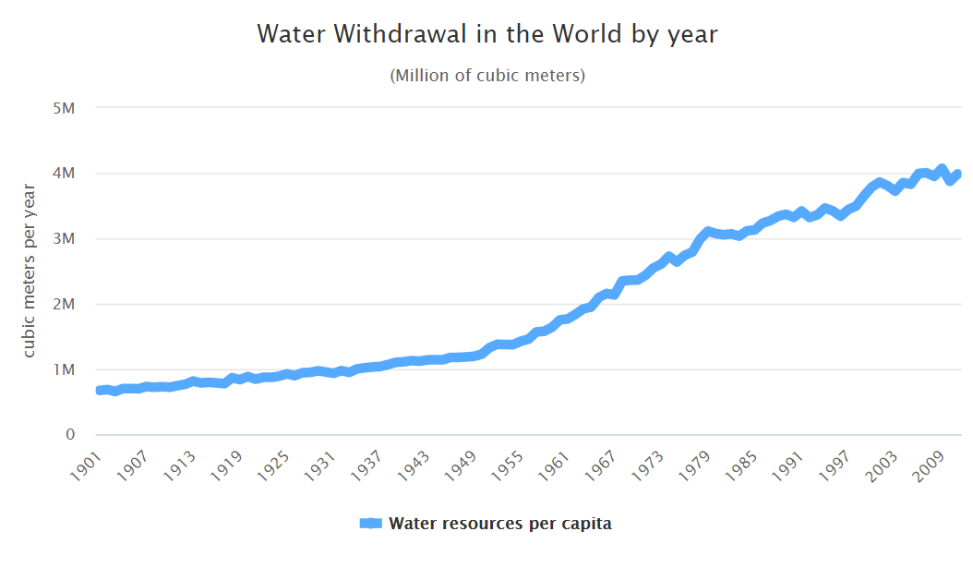
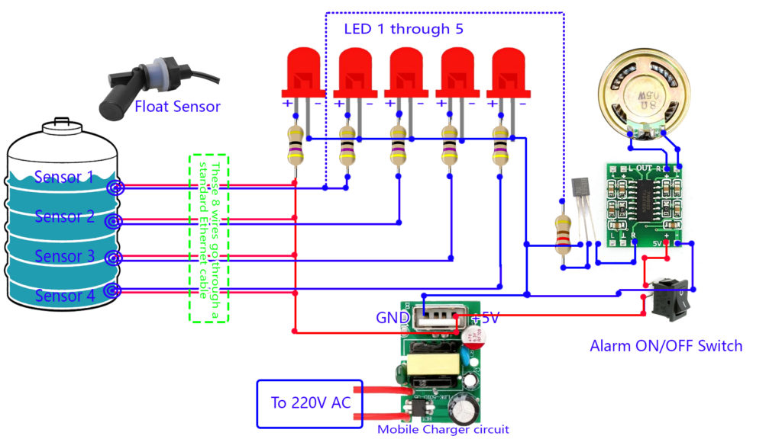
INTRODUCTION
Water is a universal solvent which plays an important role in everyday life.
Only 5%of Earth’s water is fit for human consumption. About 4% is locked in the polar ice caps, and the rest 1% constitutes all fresh water found in rivers, streams and lakes which is suitable for our consumption.
Efficient management of water is very necessary.
Water Level Indicator and Controller using Arduino project where the water is being measured by using sensors and notify the user about the water level.

Slide 3
OBJECTIVES
To gauge and manage water levels in a water tank.
To make the most commercial and reliable water level controller using as less resources as possible.
To study the controller model and observe its characteristics.
To propose any ideas or improvements that can lead to future development of the controller.

Slide 4
LITERATURE REVIEW
AUTHOR | YEAR | NAME OF PAPER | SUMMARY | PUBLICATION DETAILS
Dipanjan Rakshit, Bijit Baral, Saikat Datta, Pratyusha Biswas Deb, Priyanjali Mukherjee, Shaon Paul | 2016 | WATER LEVEL INDICATOR | The operation of water level controller works upon the fact that water conducts electricity. So water can be used to open or close a circuit. As the water level rises or falls, different circuits in the controller send different signals. These signals are used to switch ON or switch OFF the motor pump as per our requirements | International Journal of Scientific & Engineering Research, Volume 7, Issue 4, April-2016
Ms. Pooja K, Ms. Kusumavathi ,Ms. Pavithra, Ms. Nishmitha, Prof. Aishwarya D Shetty | 2020 | AUTOMATIC WATER LEVEL INDICATOR AND CONTROLLER USING ARDUINO | Implemented Automatic water level control system consisted of arduino to automate the process of water pumping in a tank and has the ability to detect the level of water in a tank and switches ON or OFF the pump accordingly with the use of ultrasonic sensor. | International Research Journal of Engineering and Technology (IRJET)

Slide 5
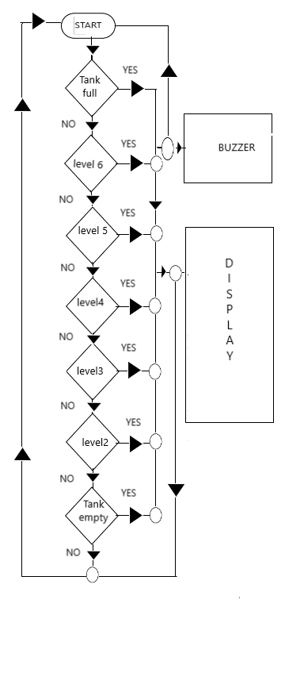
METHODOLOGY
FLOW CHART:

Slide 6
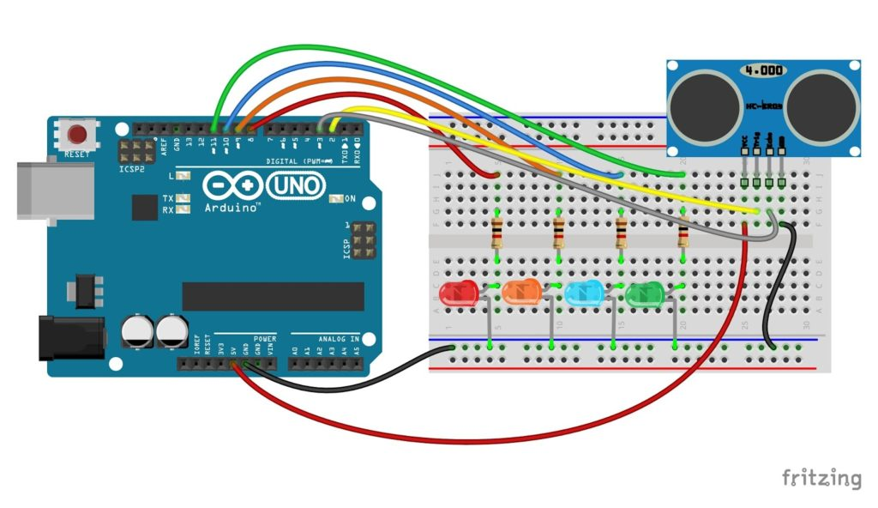
EXPERIMENTAL DETAILS
1. ARDUINO AND ULTRASONIC SENSOR
COMPONENTS USED:
Arduino UNO R3
Ultrasonic sensor
LED’s
Resistors

Slide 7
ULTRASONIC SENSOR PROGRAM
int sensorvalue = 0; Serial.begin(9600);
long readUltrasonicDistance(int triggerPin, int echoPin) pinMode(5,OUTPUT);
{ pinMode(2,OUTPUT);
pinMode(triggerPin, OUTPUT); // Clear the trigger }
digitalWrite(triggerPin, LOW); void setup()
delayMicroseconds(2); {
// Sets the trigger pin to HIGH state for 10 microsecond(s) pinMode(5,OUTPUT)
digitalWrite(triggerPin, HIGH); serial.println(sensorvalue);
delayMicroseconds(10); delay(500);//Wait for 500 millisecond(S)
digitalWrite(triggerPin,LOW); if(sensorvalue<=50)
pinMode(echoPin, INPUT); {
// Reads the echo pin, and returns the the sound wave travel time microsecond(s) digitalWrite(5,HIGH);
return pulseIn(echoPin, HIGH); }
} digitalWrite(5,HIGH); if(sensorvalue > 51){
void setup() digitalWrite(2,HIGH);
{ }}

Slide 8
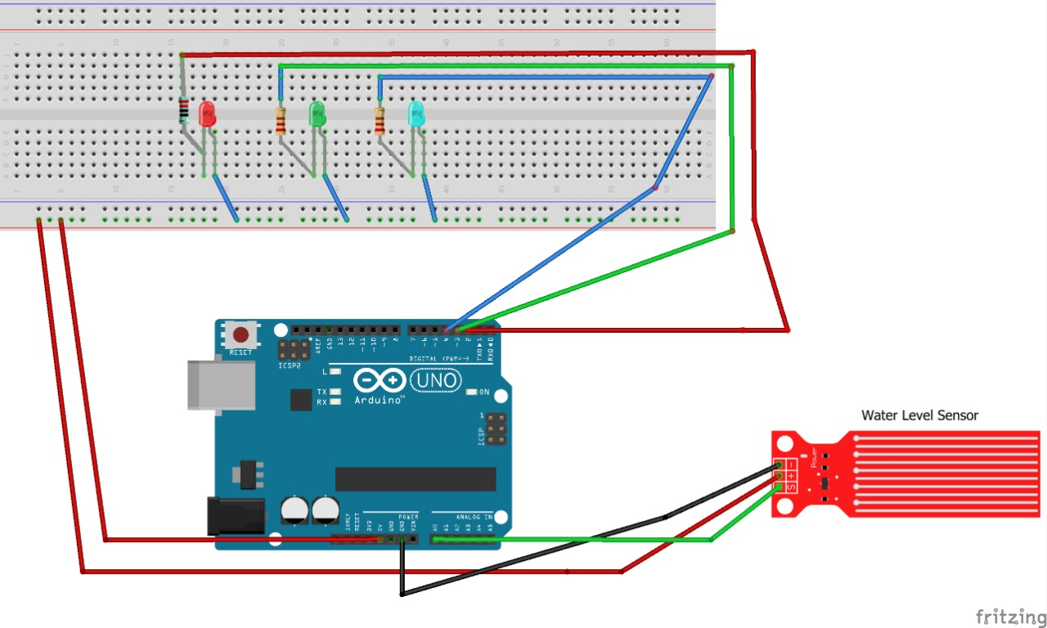
EXPERIMENTAL DETAILS
Program: else if ((value > 300) && (value <= 500)) }
int red=2; Serial.println("Moderate Level");
int green=3; digitalWrite (green,HIGH);
int blue=4; digitalWrite (red,LOW);
void setup () }
pinMode (red,OUTPUT); else{
pinMode (green,OUTPUT); Serial.println("Low level");
pinMode (blue,OUTPUT); digitalWrite (blue,HIGH);
Serial.begin (9600);} digitalWrite (red,LOW);
void loop() { digitalWrite (green,LOW);
// read the input on analog pin 0: delay(100);
int value = analogRead(A0); }
if (value > 500) }
Serial.println("High Level ");
digitalWrite (red,HIGH);
digitalWrite(green,LOW);
digitalWrite(blue,LOW);}
2. ARDUINO AND WATER SENSOR
COMPONENTS:
Arduino UNOR3
Water Sensor
LED’s

Slide 9
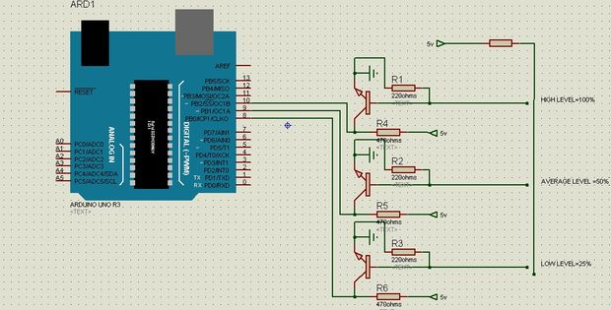
EXPERIMENTAL DETAILS
PROGRAM: else
byte sensorPin[] = {8, 9, 10}; {
byte ledPin[] = {11, 12, 13}; digitalWrite(ledPin[i], LOW);
// number of leds = numbers of sensors }
const byte sensors = 3; }
int level = 0; Serial.println("Water level");
void setup() switch(level)
{ {
Serial.begin(9600); case 1:
for(int i = 0; i < sensors; i++) Serial.println("HIGH");
{ break;
pinMode(sensorPin[i], INPUT); case 2:
pinMode(ledPin[i], OUTPUT); Serial.println("AVERAGE");
} break;
} case 3;
void loop() Serial.println("LOW");
{ break;
level = 0; default;
for(int i = 0; i < sensors; i++) Serial.println("NO WATER");
{ break;
if(digitalRead(sensorPin[i]) == LOW) }
{ delay(50);
digitalWrite(ledPin[i], HIGH); }
level = sensors - i;
}
3. ARDUINO AND TRANSISTORS
COMPONENTS:
Arduino UNO R3
Transistor
Resistors

Slide 10
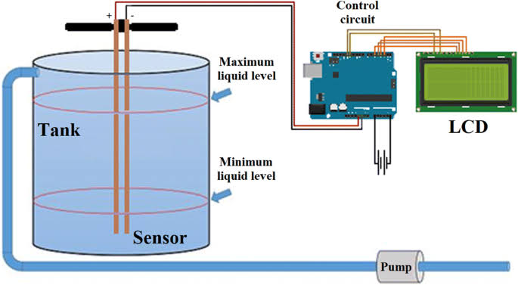
EXPERIMENTAL DETAILS
const int numRows = f=4; water = cs_22_23.capSenseRaw(200); const int numCols = 20; water = cs_22_23.capSenseRaw(200); //This sets the pins for the lcd (RS, Enable, data 0-7) //Then fill up the conataner LiquidCrystal lcd (53, 52, 51, 50, 49, 48,47,46,45,44); //is as close to 100 as possible. #define Tempin 0x48 //water = water / 93; #define Tempout 0x49 lcd.setCursor(0,0); CapSense cs_22_23 = CapSense(22,23); lcd.print(“Water"); uint8_t block[8] = {0xFF,0xFF,0xFF,0xFF,0xFF,0xFF,0xFF,0xFF}; lcd.setCursor(0,0); uint8_t tl[8] = {0x0F,0x08,0x08,0x08,0x08,0x08,0x0F,0x0F}; lcd.print(water); uint8_t tr[8] = {0x16,0x11,0x11,0x11,0x11,0x11,0x1D,0x15}; if (fuel >= 6) { uint8_t bl[8] = {0x0F,0x0F,0x0F,0x0F,0x0F,0x0F,0x0F,0x1F}; lcd.setCursor(1,3); uint8_t br[8] = {0x15,0x15,0x15,0x15,0x15,0x15,0x12,0x18}; lcd.print(2, BYTE); void setup() { } else { lcd.begin(numRows, numCols); lcd.setCursor(1,3); lcd.createChar(4, tl); lcd.print(“Water "); lcd.createChar(5, tr); } lcd.createChar(6, bl); delay(50); lcd.createChar(7, br); } lcd.setCursor(18,0); lcd.print(4, BYTE); lcd.setCursor(19,0); lcd.print(5, BYTE); lcd.setCursor(18,1); lcd.print(6, BYTE);
lcd.setCursor(19,1); lcd.print(7, BYTE); lcd.setCursor(0,2); lcd.print(“Water "); lcd.setCursor(0,3); lcd.print("E"); } void loop() { long water; lcd.createChar(2, block); long start = millis();
4. ARDUINO AND CAPACITIVE SENSOR
COMPONENTS:
Arduino UNO R3
Capacitor
LCD Display

Slide 11
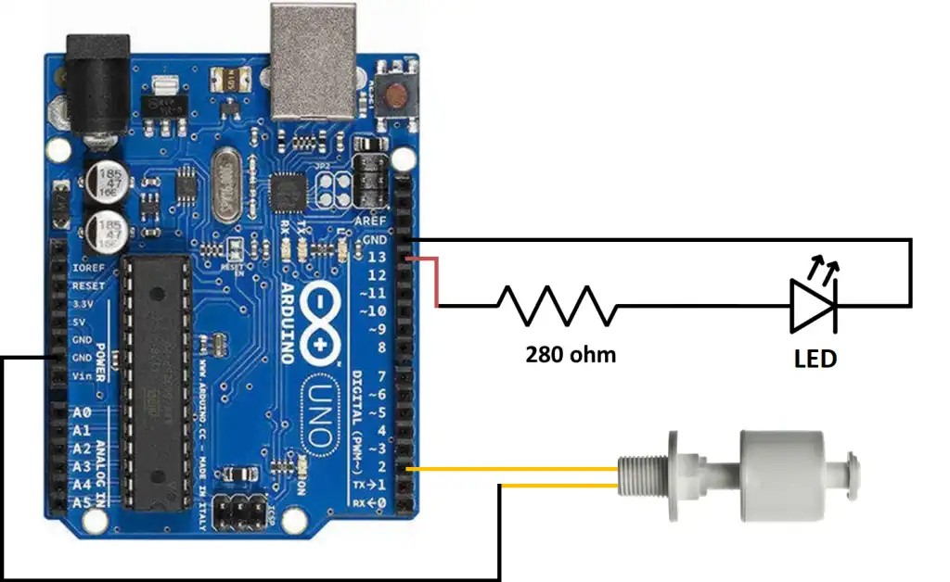
EXPERIMENTAL DETAILS
PROGRAM:
int FloatSensor = 2; }
int led = 13; else {
int buttonState = 1; digitalWrite(led, HIGH);
//reads pushbutton status Serial.println("WATER LEVEL - HIGH");
void setup() { }
Serial.begin(9600); delay(1000);
pinMode(FloatSensor, INPUT_PULLUP); }
pinMode (led, OUTPUT);
}
void loop() {
buttonState = digitalRead(FloatSensor);
if (buttonState == HIGH) {
digitalWrite(led, LOW);
Serial.println("WATER LEVEL - LOW");
5. ARDUINO AND FLOATING SENSOR
COMPONENTS:
Arduino UNO R3
Floating sensor
Resistance
LED

Slide 12
ADVANTAGE AND DISADVANTAGE
ADVANTAGES
Power saver
Money Saver
Automatic
Water maximization
Reliable Electronic Design
Easy Installation with LED Monitoring
DISADVANTAGES
Water level controls need to be replaced every 3 years.
The rust, foul and deteriorate
Electronics are usually built separately
More difficult installation
Most float switches are outdated
No LED indicator lights
No Warranty or Guarantee

Slide 13
RESULT AND DISCUSSION
The water level Indicator employs a simple mechanism to detect and indicate the water level in an over head tank or any other water container.
This system is very beneficial in rural as well as urban areas. It helps in the efficient utilization of available water sources. If used on a large scale, it can provide a major contribution in the conservation of water for us and the future generations.
Water level controller is a simple yet effective way to prevent wastage of water.
Its simplicity in design and low cost components make it an ideal piece of technology for the common man.

Slide 14
REFERENCES
Ms. Pooja K, Ms. Kusumavathi ,Ms. Pavithra, Ms. Nishmitha, Prof. Aishwarya D Shetty, “Automatic water level indicator and controller using arduino”, International research journal of engineering and technology (IRJET),V-7, Issue-05/2020.
Dipanjan Rakshit, Bijit Baral, Saikat Datta, Pratyusha Biswas Deb, Priyanjali Mukherjee, Shaon Paul, “Water level indicator”, International Journal of Scientific & Engineering Research, Volume 7, Issue 4, April-2016.
Source links:
https://www.worldometers.info/water/
Water-Level-Indicator literature review.pdf
IRJET-V7I51024.pdf

Slide 15
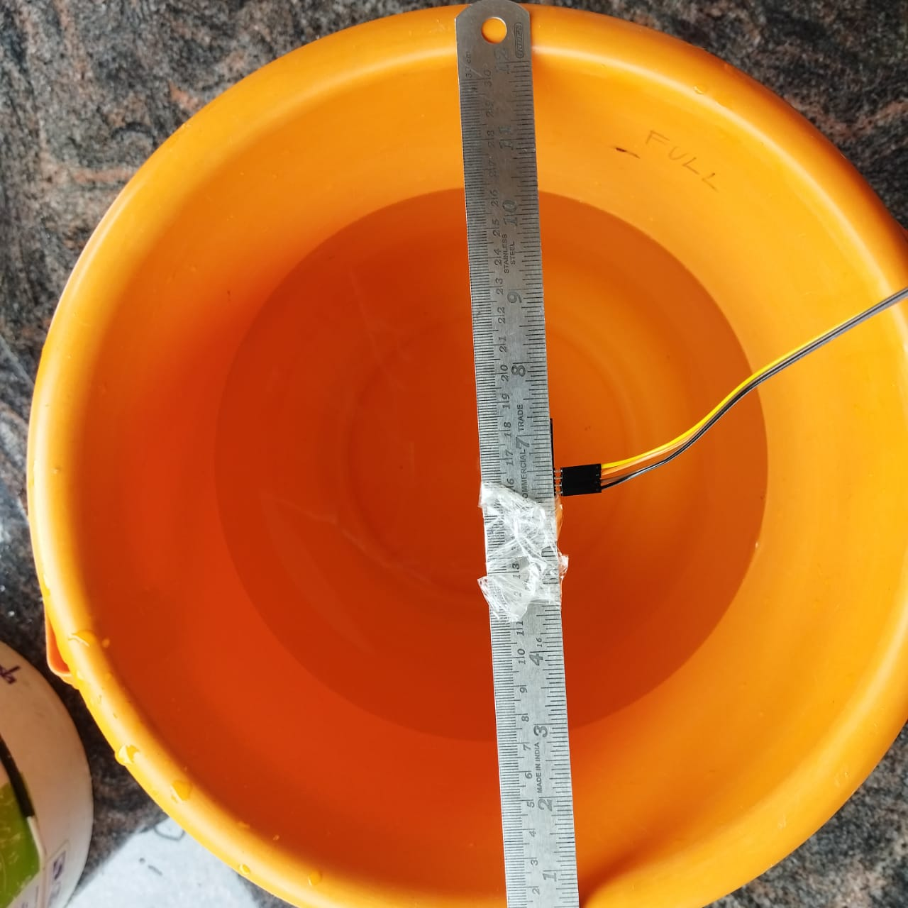
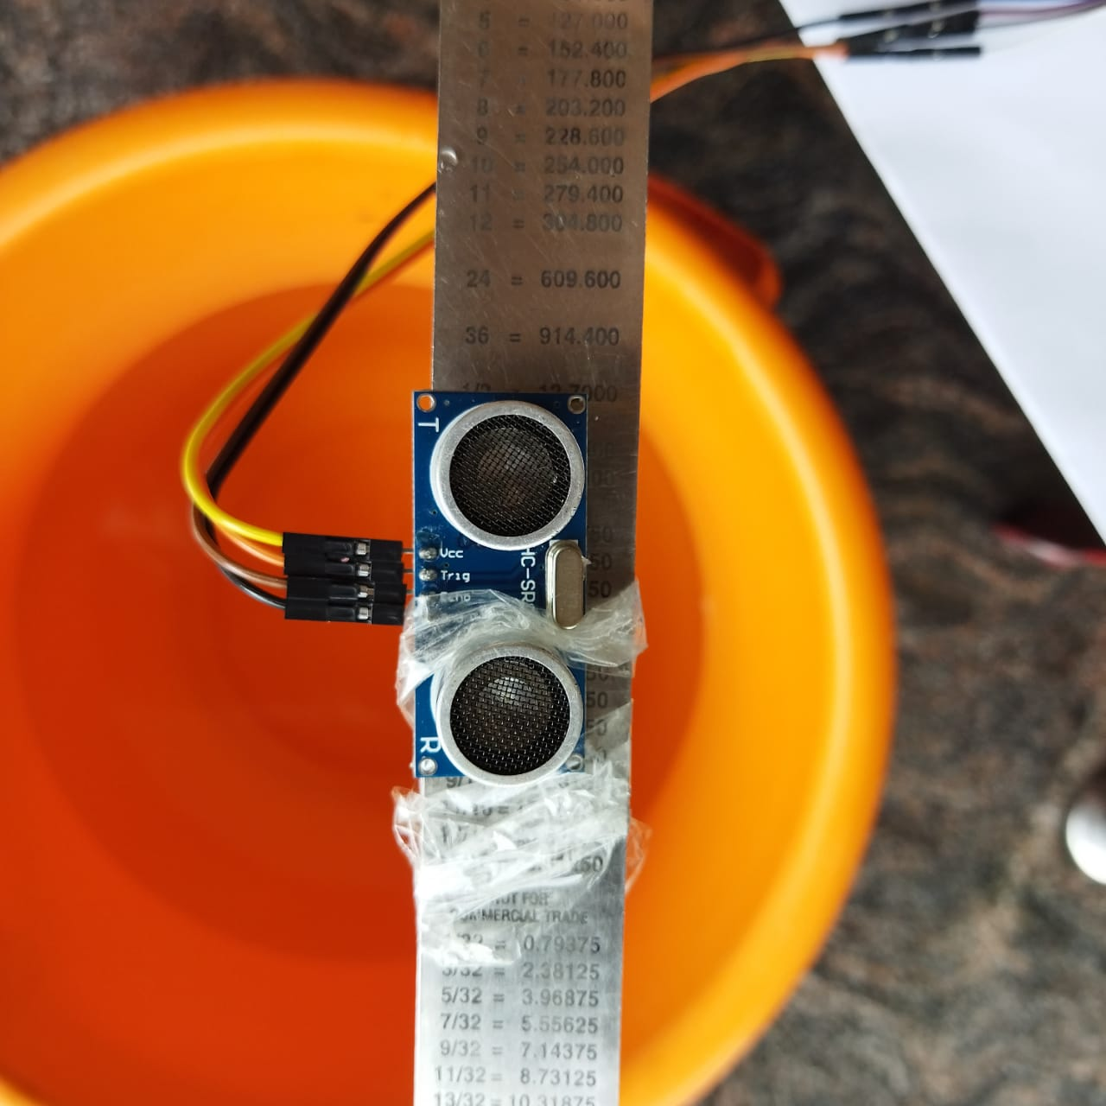
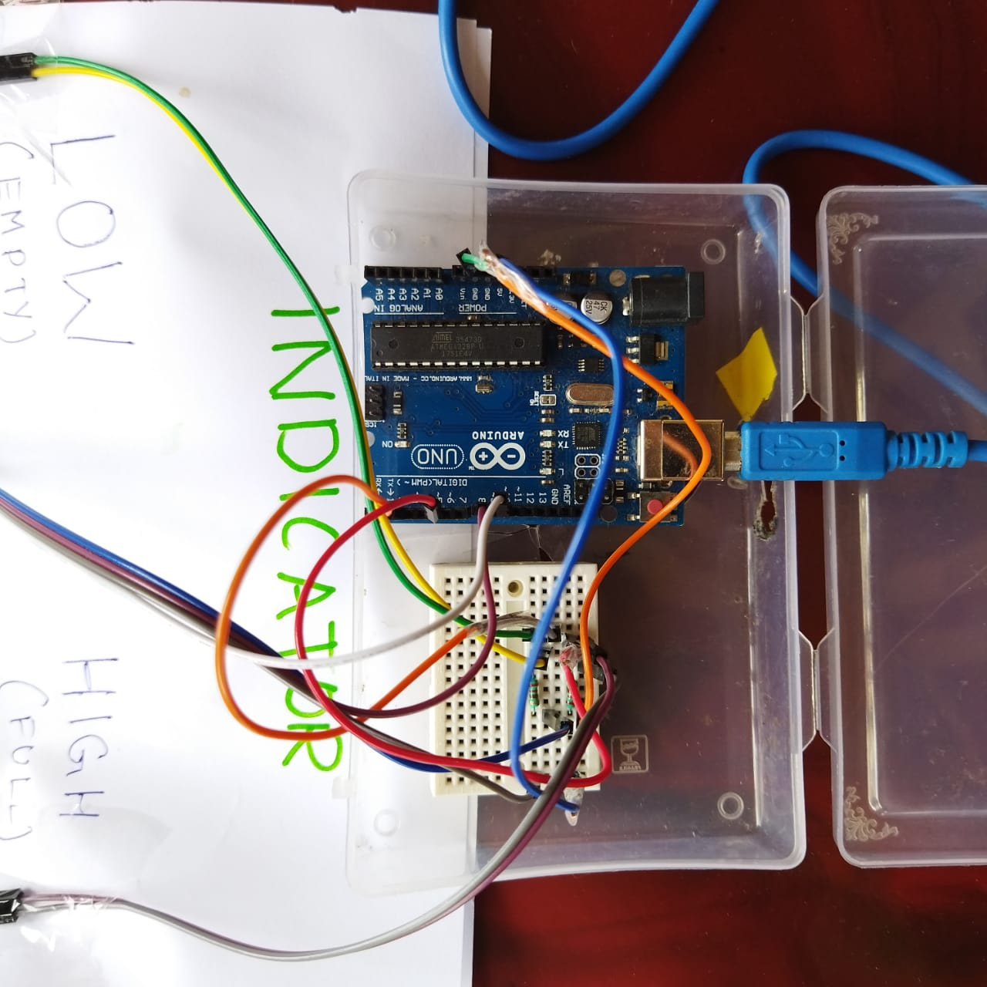
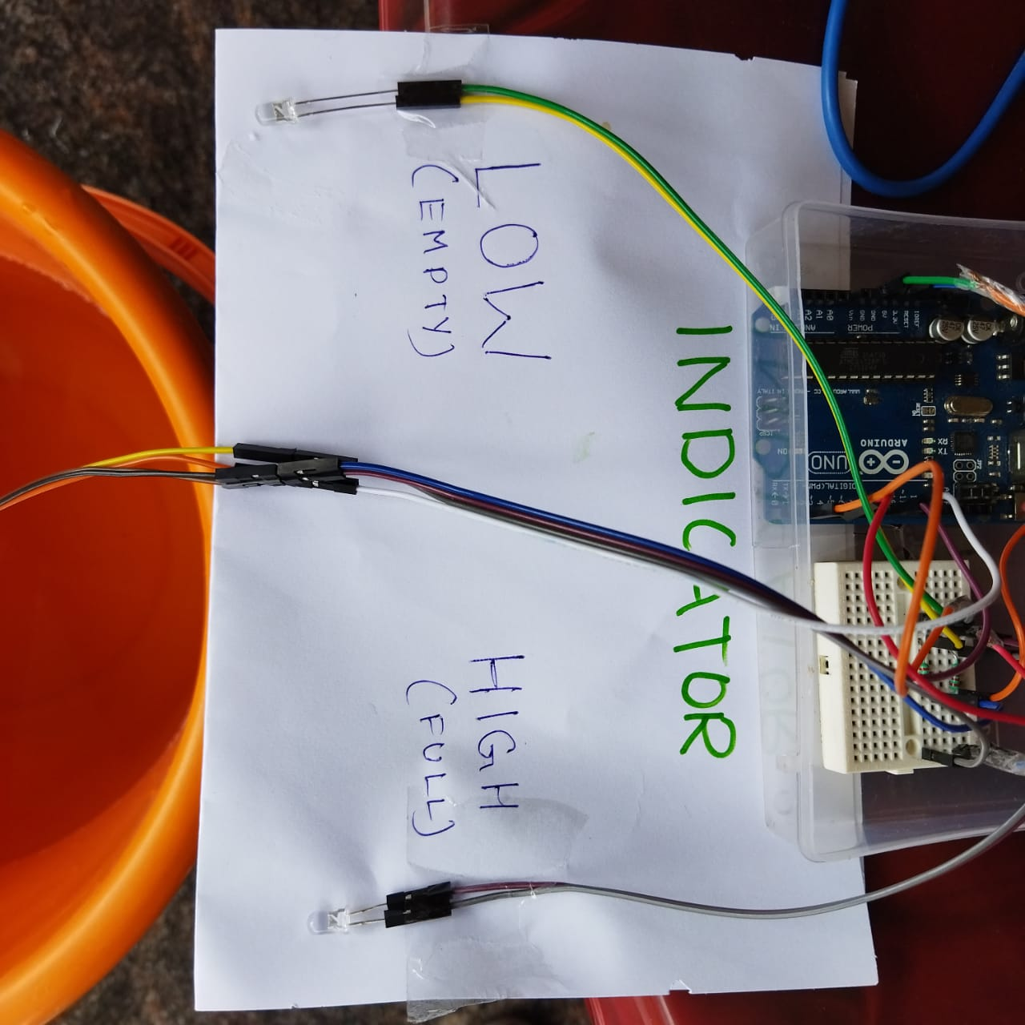
DEMONSTRATION

Slide 16
THANK YOU

